Slide 1
Postcardbuddy
Team c

Slide 2
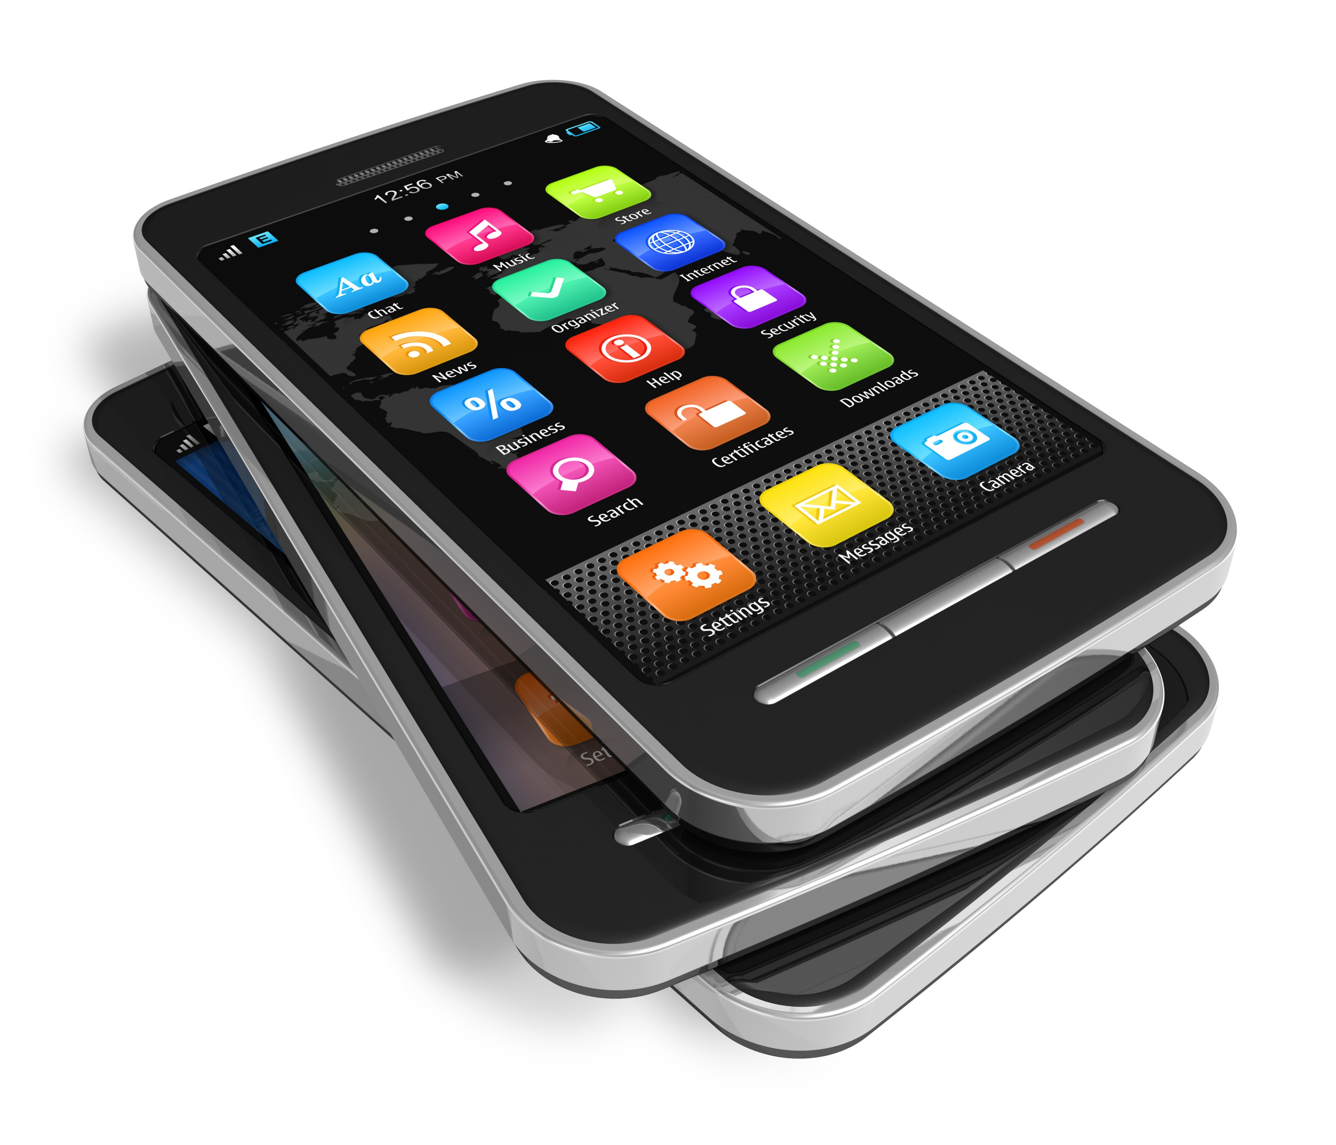

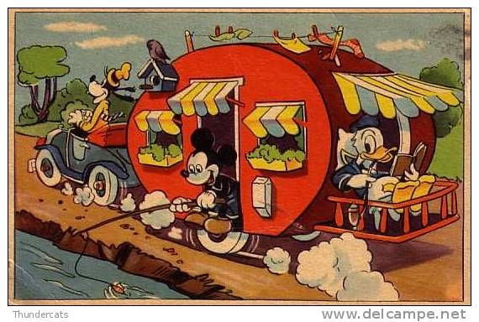
What is postcardbuddy?
Simple
Personal
Generate revenue

Slide 3

Elicitation
Brainstorming
Stakeholder analysis
Questionnaire
Interviews
Prototypes
Document study

Slide 4

stakeholders
Mobile user
Printer of postcards
Postal service
Developers
Payment service
”riktiga vykort”

Slide 5
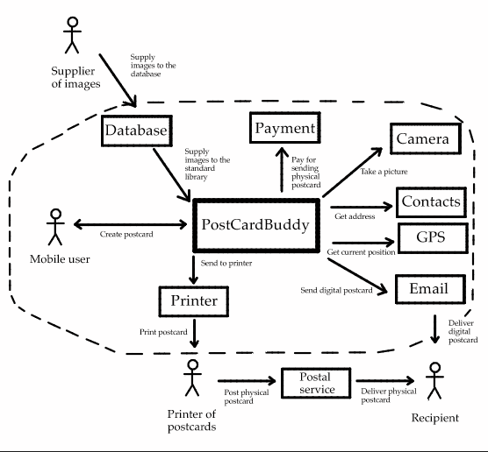
Context

Slide 6
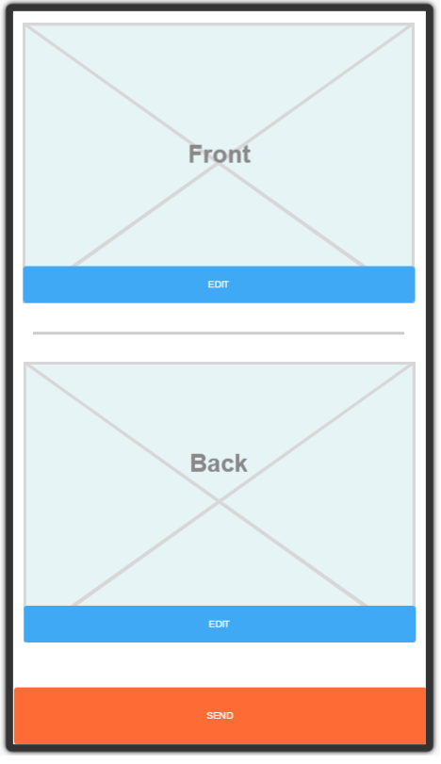
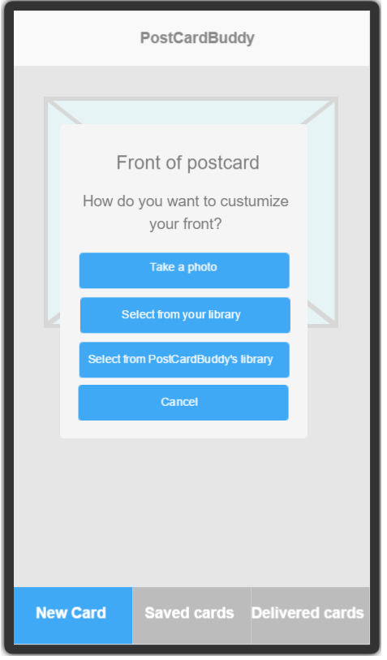

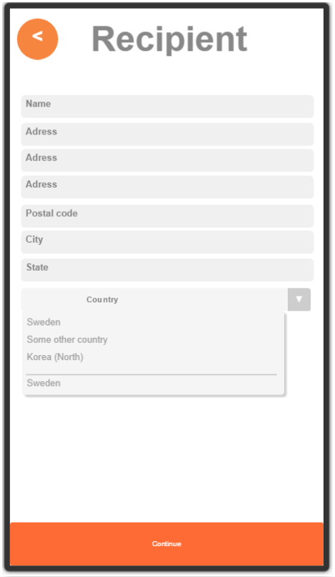
prototype

Slide 7

Outcomes
Data model/dictionary
Virtual windows
Quality grid
Quper
Release plan

Slide 8

Project experiences
A process not a task
Many ways and levels to specify requirements
Important to validate

Slide 9

Challenges
finding a common and precise view
prioritization
Get a hold of stakeholders

Slide 10

Thank YOU!

